Slide 1
PRACTICAL IMPLEMENTATIONS OF AWS SERVICES
SUBMITTED BY
- M . SRI RESHMA LAKSHMI (20A31A1214)

Slide 2
1. ec2 instances
STEPS TO LAUNCH AN INSTANCE :
In the AWS Management Console choose Services, choose Compute and then choose EC2.
Choose the Launch instance menu and select Launch instance.
Give the instance the name.
In the list of available Quick Start AMIs, select the required AMI
In the Instance type panel, select the required storage , cpu , memory and networking requirements.
For Key pair name - required, choose vockey or create new one.
And then keep remaining to default and launch an instance
After some time , the instance is launched and you can connect with SSH or through cloud shell.
After completion of usage stop the instance and terminate it .

Slide 3
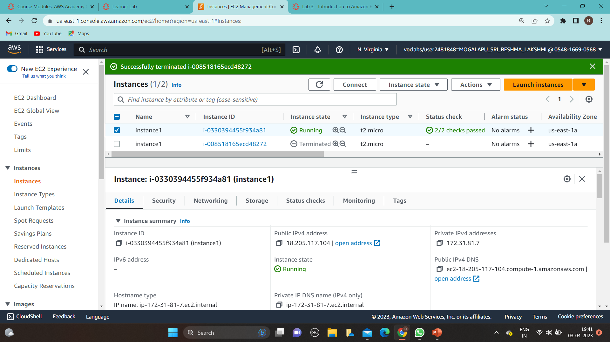

Slide 4
2. IAM
In the AWS Management Console, on the Services menu, select IAM.
In the navigation pane on the left, choose Users.
Choose the Security credentials tab.
In the navigation pane on the left, choose User groups.
Choose the Permissions tab.
Choose the plus (+) icon next to the policies/permissions .
Choose the permission that you want to assign to the specified user
After in security tab , choose the link and give the username and password and login to the console , the specified permission for the user created.
The user now can perform only that action.

Slide 5
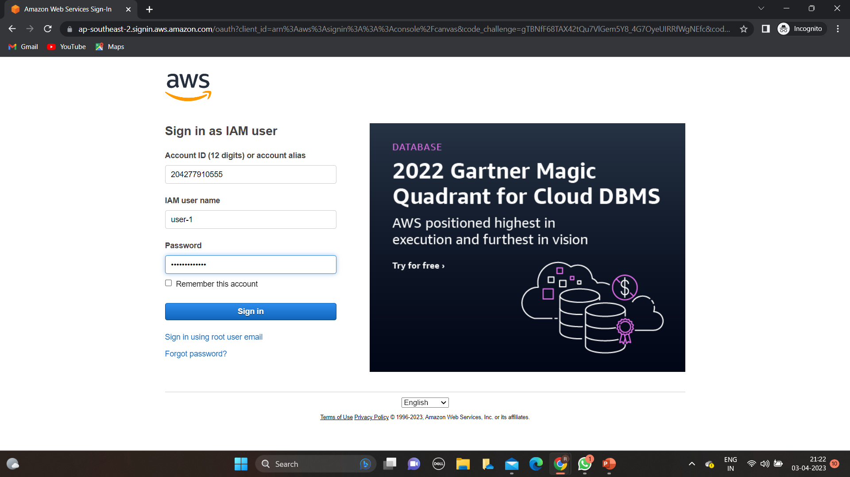

Slide 6
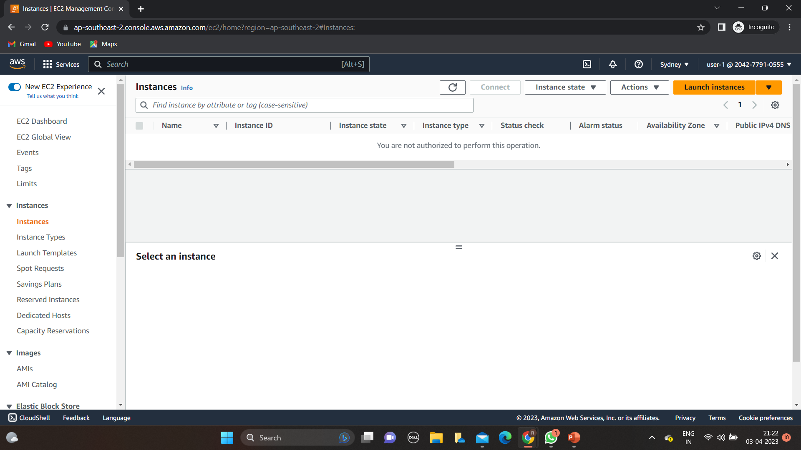

Slide 7
3.cloudwatch(billing alarm)
After logging into console choose cloudwatch
In left panel choose billing , create alarm
Then select metric → billing→total estimated charges→tickmark→select metric
In metric currency change to rupee from usd
Then in threshold choose greater than option and give the amount ,in alarm trigger choose inalarm and choose sns topic and next and create alarm

Slide 8
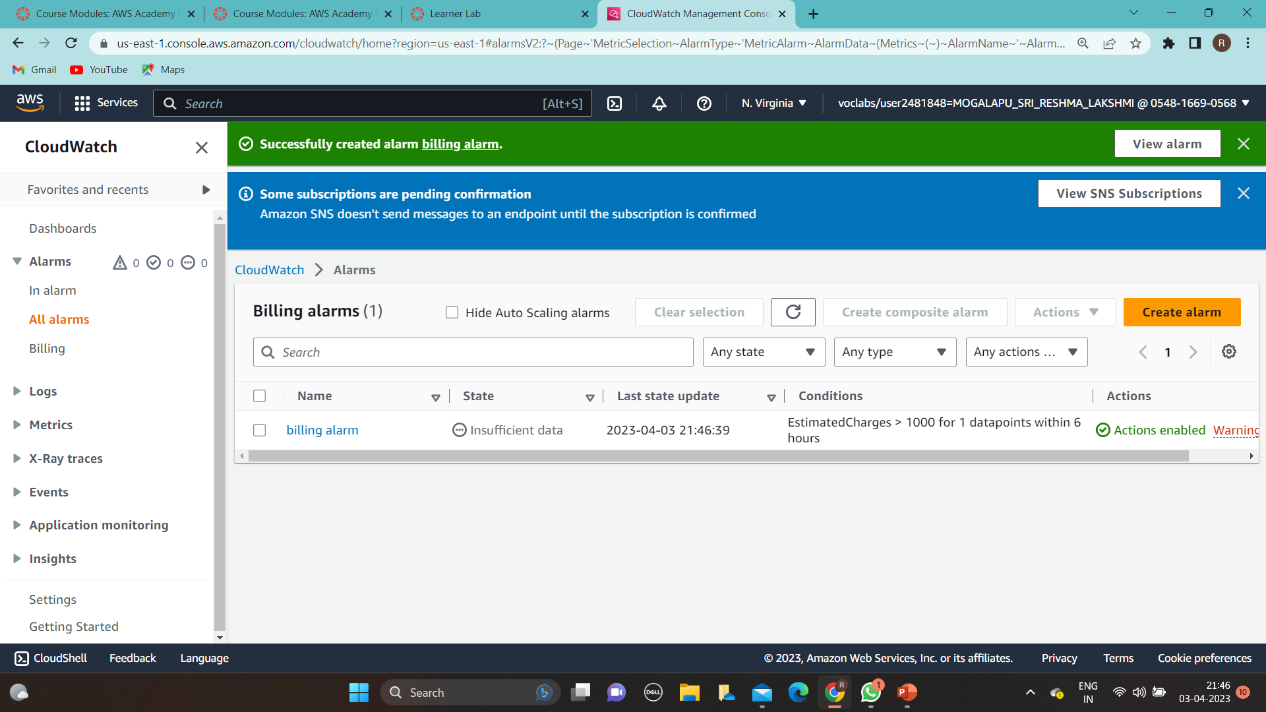

Slide 9
4.CLI (command line interface)
After installing amazon CLI open command prompt and type aws configure.
Then it will ask aws access key
Go to the IAM service. Click on the "Users" option in the left-hand menu.
Select the user for whom you want to find the access key.
Click on the "Security credentials" tab.
Scroll down to the "Access keys" section
Then CLI is open to perform actions.

Slide 10
5.Subnet
Log in to the AWS Management Console and go to the VPC service.
Click on the "Subnets" option in the left-hand menu.
Click on the "Create subnet" button.
Choose the VPC where you want to create the subnet.
Choose the availability zone where you want to create the subnet.
Enter a name for the subnet.
Enter the CIDR block for the subnet. The CIDR block must be a subset of the CIDR block that you defined for the VPC.
If you want to enable auto-assign public IP addresses for instances launched in this subnet, select the "Auto-assign IPv4" checkbox.
Click on the "Create" button to create the subnet.
Your new subnet will now be listed in the Subnets section of the VPC dashboard.

Slide 11
6.Security Groups
Log in to the AWS Management Console and go to the EC2 service.
Click on the "Security Groups" option in the left-hand menu.
Click on the "Create Security Group" button.
Enter a name and description for the security group.
Select the VPC where you want to create the security group.
In the "Inbound Rules" tab, click on the "Add Rule" button.
Choose the protocol, port range, and source for the inbound rule. For example, you can create a rule to allow incoming traffic on port 80 from anywhere.
Click on the "Save rules" button to create the inbound rule.
If you need to create additional inbound rules, repeat steps 6 to 8.
In the "Outbound Rules" tab, click on the "Add Rule" button.
Choose the protocol, port range, and destination for the outbound rule. For example, you can create a rule to allow outgoing traffic to anywhere on port 443.
Click on the "Save rules" button to create the outbound rule.
If you need to create additional outbound rules, repeat steps 10 to 12.
Review the details of the security group and click on the "Create Security Group" button.
Your new security group will now be listed in the Security Groups section of the EC2 dashboard.

Slide 12
7.ELB(ELASTIC LOAD BALANCER)
Log in to the AWS Management Console and go to the EC2 service.
Click on the "Load Balancers" option in the left-hand menu.
Click on the "Create Load Balancer" button.
Choose the type of load balancer you want to create.
Enter a name for your load balancer and choose the VPC where you want to deploy it.
Configure the listeners for the load balancer, which specify the protocols and ports that the load balancer uses to receive traffic from clients.
Configure the target groups for the load balancer, which specify the targets for the load balancer to route traffic to. Targets can be EC2 instances, IP addresses, or Lambda functions.
Configure health checks for the target groups, which specify the protocol, port, and path to use for health checks.
If you are using an Application Load Balancer or a Network Load Balancer, configure the routing rules for the load balancer. Routing rules specify how traffic should be distributed to the different target groups based on various criteria.
Review the details of the load balancer and click on the "Create" button to create it.
Your new load balancer will now be listed in the Load Balancers section of the EC2 dashboard.

Slide 13
8.VPC(virtual private cloud)
Log in to the AWS Management Console and go to the VPC service.
Click on the "Your VPCs" option in the left-hand menu.
Click on the "Create VPC" button.
Enter a name and CIDR block for the VPC. The CIDR block determines the range of IP addresses that can be used in the VPC.
Choose the tenancy option for the VPC. The default option is "Shared Tenancy," whichmeans that multiple AWS accounts can use the same physical hardware. If you choose "Dedicated Tenancy," the VPC will run on dedicated hardware.
Click on the "Create VPC" button.
Your new VPC will now be listed in the VPC dashboard.
To create a subnet, click on the "Subnets" option in the left-hand menu.
Click on the "Create subnet" button.
Enter a name for the subnet and choose the VPC that you just created.
Choose the availability zone where you want to create the subnet.
Enter the CIDR block for the subnet. The CIDR block must be a subset of the CIDR block that you defined for the VPC.
Click on the "Create" button to create the subnet.
Your new subnet will now be listed in the Subnets section of the VPC dashboard.

Slide 14
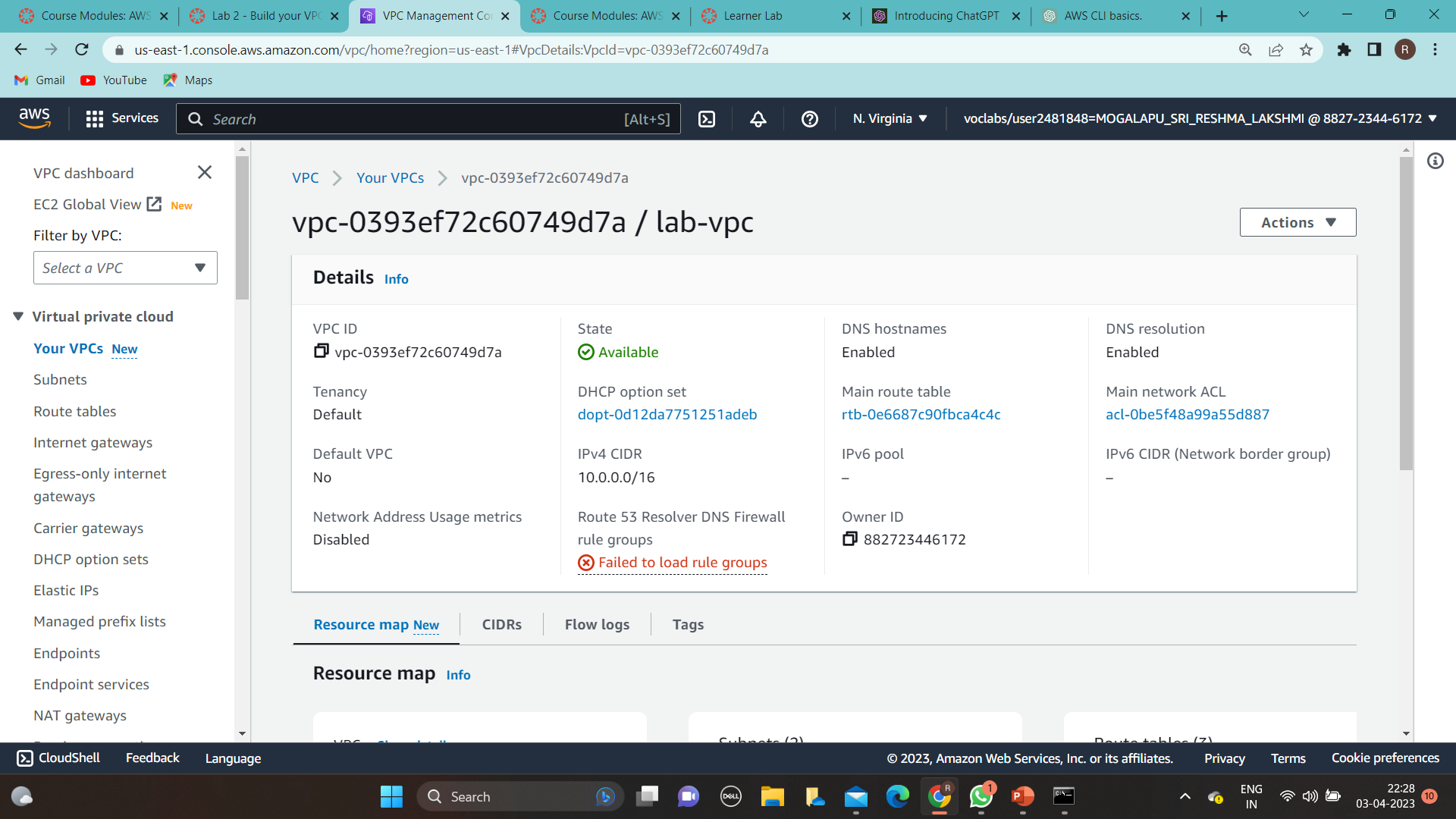

Slide 15
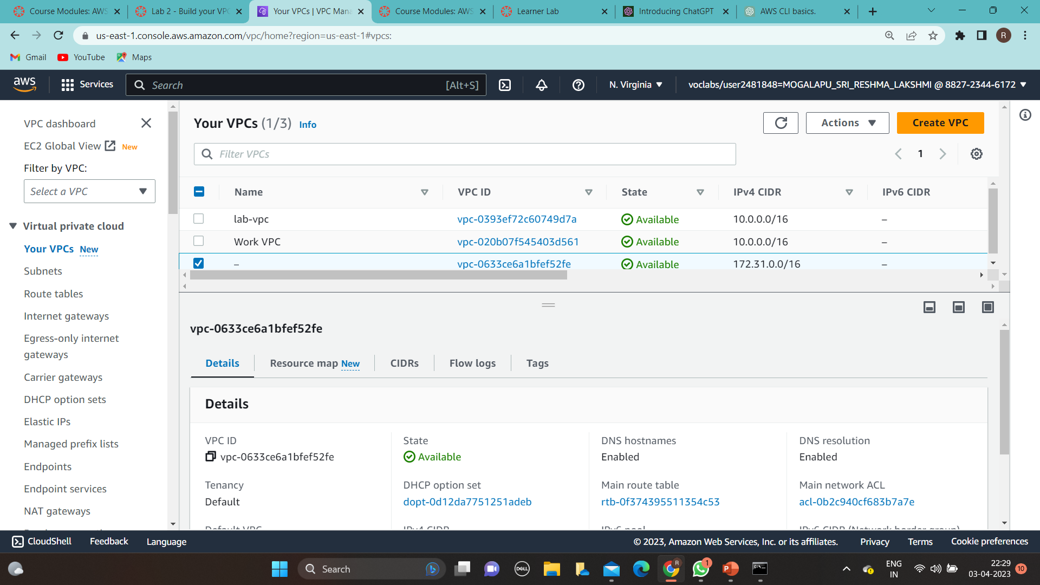

Slide 16
9.AMI(AMAZON MACHINE IMAGE)
Launch an ec2 instance.
Stop the ec2 instance.
Select the instance go to actions → image & template → create image .
Give the name of the image .
Launch a instance from AMI image

Slide 17
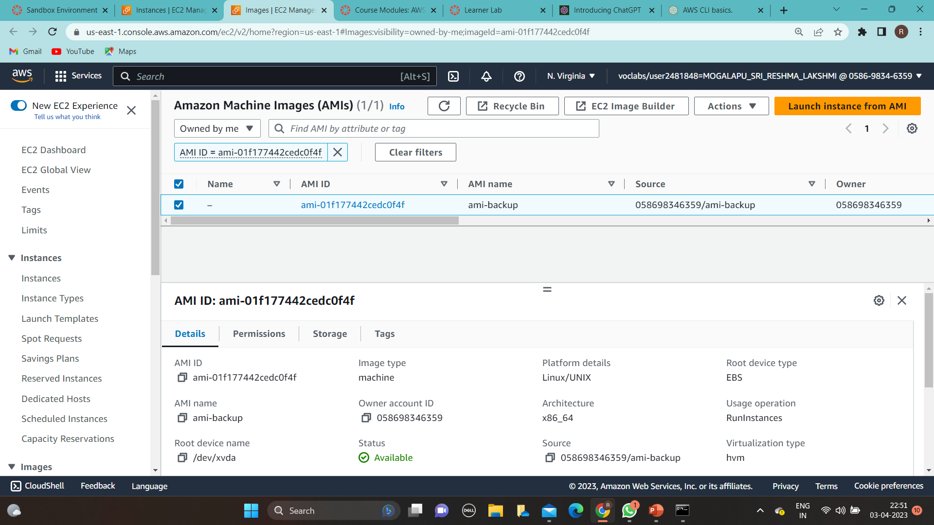

Slide 18
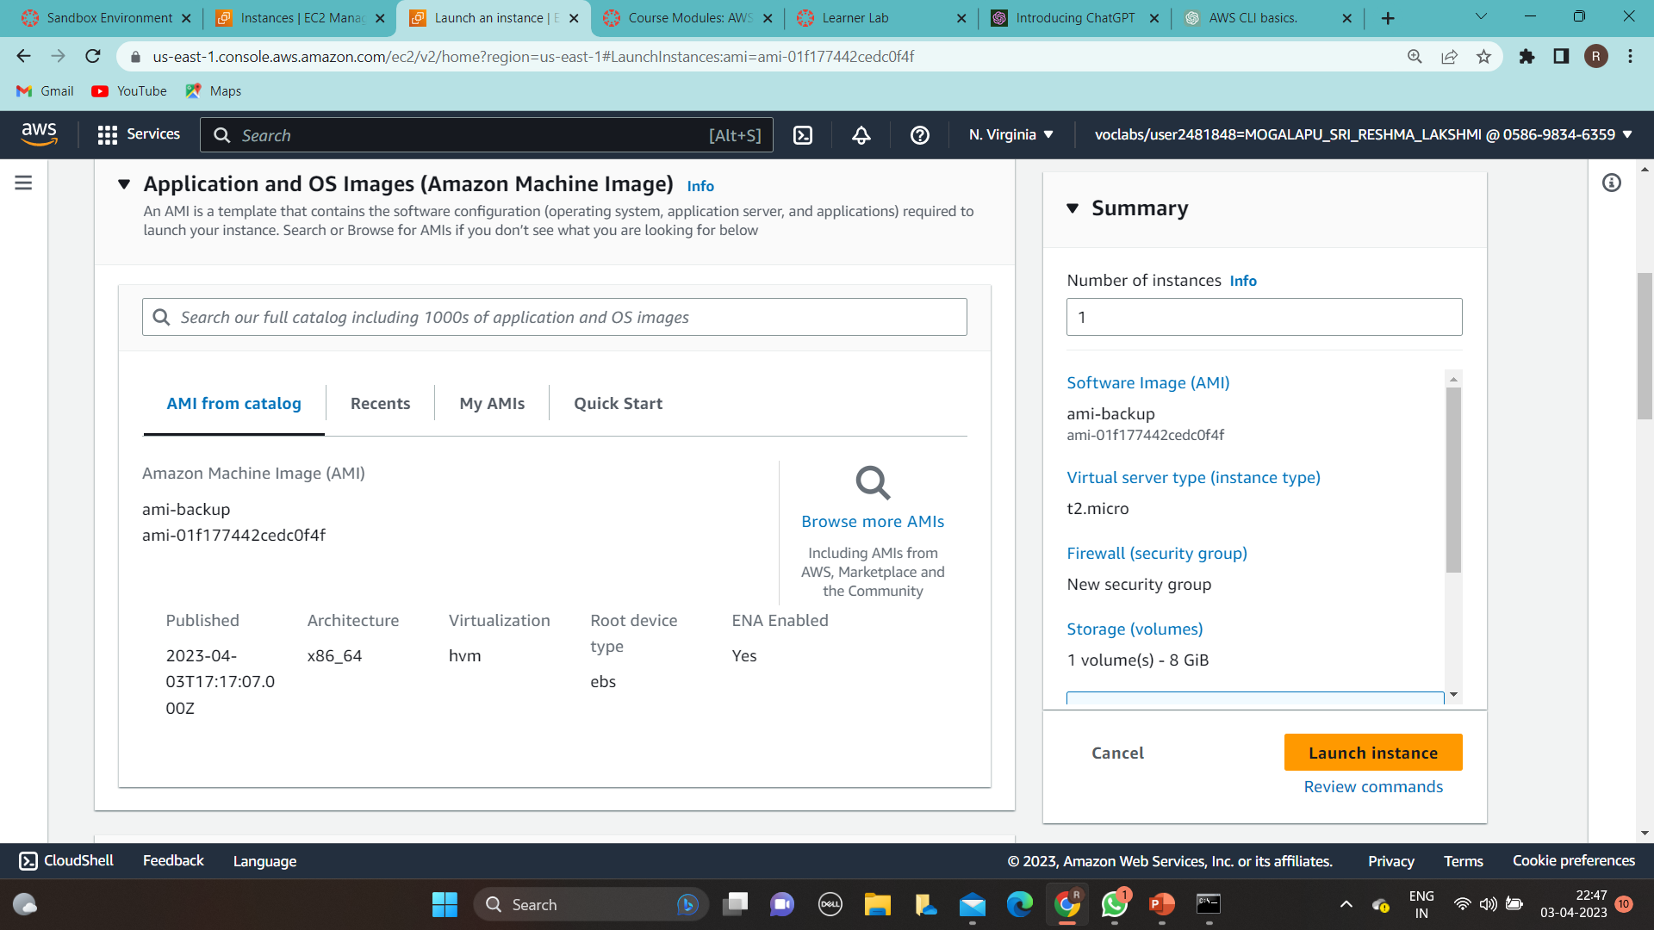

Slide 19
10.EBS(ELASTIC BLOCK STORE)
Log in to the AWS Management Console and go to the EC2 service.
Click on the "Volumes" option in the left-hand menu.
Click on the "Create Volume" button.
Choose the volume type , ssd , size , availability zone
Click on the "Create" button to create the volume.
Your new EBS volume will now be listed in the Volumes section of the EC2 dashboard.
Attach the EBS volume to an EC2 instance by selecting the volume and clicking on the "Actions" button and then "Attach Volume". Choose the instance and the device name (e.g. /dev/sdf) where you want to attach the volume.
Once attached, you may need to format the volume and mount it on the instance. This can be done through the instance's operating system. For example, in Linux, you would use commands like "mkfs" and "mount" to format and mount the volume.

Slide 20
11.Launch template
Go to ec2 instances
In the left plane goto launch template
Then create an a template based on the requirements you have
Mention all the requirements and then create the template
Now you can use the template whenever you want the requirements that already met in the template.

Slide 21
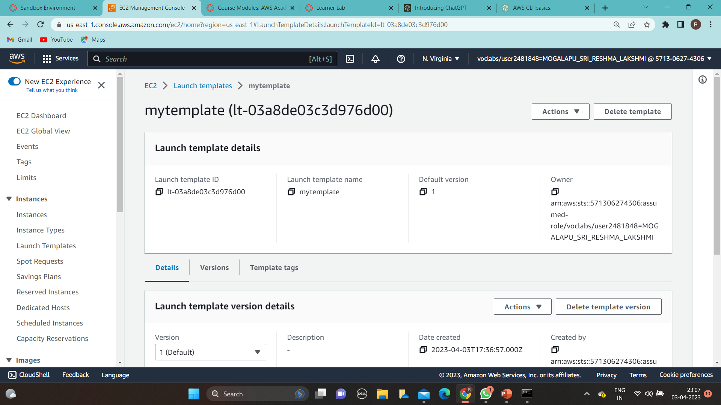

Slide 22
